Slide 1
Flappy Bird
Abstract—In this document we describe our project on Flappy Bird game, using python.

Slide 2
Language used:-
Python
Using VS Code

Slide 3
Libraries :-
Game.py: Defines an abstract game class.
FlappyGame.py: Defines the flappy bird game.
Player.py: Defines the player classes which we used in the game.
AgentFlappyGame.py: Extends FlappyGame to use an agent.
Agent.py: Defines various agent classes and state classes.
Main.py: A script for manually setting the game parameters.
TestScript.py: Used for running flappy game with an agent with various combinations of parameters

Slide 4
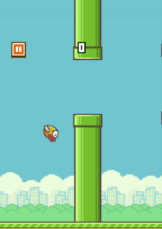
Introduction
Flappy Bird is a 2013 mobile game, developed by Vietnam-based developer Dong Nguyen and published by GEARS Studios, a small independent game developer also based in Vietnam. The game is a side-scroller where the player controls a bird, attempting to fly between rows of green pipes without hitting them. The objective is to direct a flying bird, named Faby, who moves continuously to the right, between sets of Mario-like pipes. If the player touches the pipes, they lose. Faby briefly flaps upward each time that the player taps the screen; if the screen is not tapped, Faby falls because of gravity; each pair of pipes that he navigates between earns the player a single point.

Slide 5
Goal
Using learning algorithms we want to allow AI player to do a training set with different definitions of states , and learn the flappy bird world. After the training set we want the player to successfully continue playing as long as we want without any hit. We can examine the learning success using different parameters as number of training runs, learning rate, discount factor etc.

Slide 6
Approach
We chose to use learning against search methods because of Flappy Bird is a continuous and dynamic game, the environment is not predefined, and we wanted to create agent that can take a first phase of learning and then play the game fluently. Q-learning algorithm is the most fit to our problem because the algorithm builds a policy and then can manage the states it will counter during the game. In order to make effective learning we needed to defined the state space of the problem. We found that there are 3 elements that we want to include in the state space:
Vertical distance from the lower pipe.
Horizontal distance from the lower pipe.
Bird's velocity. We assumed that those 3 elements are the most important to describe a current state of the bird.

Slide 7
Design
Our design process is to first create all static interfaces and buttons associated with each interface. Then we started to create player mode, including pipe and background shifting, bird falling or jumping, score and life tracking, sound effect. Then we created a backend file and read/write to it when store new record.

Slide 8
Testing
We tested our program in the same way as the developing steps. We tested the overall structure of the game by traversing each interface, and test the player mode by checking the update of the score and life when bird moves. One difficulty is that we need the user to input to store their score. However, pygame does not contain type-in box to get the keyboard input. Therefore, we added a new interface and transfer the keyboard input to string and draw the string on the screen.

Slide 9
Future Work
We want to create the bird rotating effect when jumping or falling. Also, we can increase the game difficulity by decreasing the gap between pipes as time goes on. Finally, we can increase the game difficulity by making pipes move up and down as time goes on.

Slide 10
Result
Everything in our project performed as planned and our team meets the goals outlined in the description. We designed a new flappy bird game. In the demo, we encouraged Vedant or Aman or Aman to play the game, which gave everyone a lot of fun. Finally, the project got the highly praise from Vedant ,Vishal, Aman and some of our other friends as well.

Slide 11
CONCLUSION
Our final project was planned, developed and demonstrated as expected. We designed a new version of Flappy Bird Game written in Python, which could be played either on personal computer. Firstly, a user-friendly interface was implemented. Secondly, player mode was realized. In player mode, each player have 3 lives and their final scores will be written to a score board, which keeps track of top scores. One difficulty for users is that the horizontal shifting speed will increasing as time goes on. We also implemented a hidden trick in the player mode.

Slide 12
Work Distribution
Interfaces Creation: Aman
Bird Control: Vishal
Player mode: Vedant , Vishal ,Aman (as it was quite time demanding)
Screen Shifting: Vedant
Random Pipe: Aman
Sound Effect: Vishal

Slide 13
References
Python reference
Pygame tutorials
Pygame documents

Slide 14
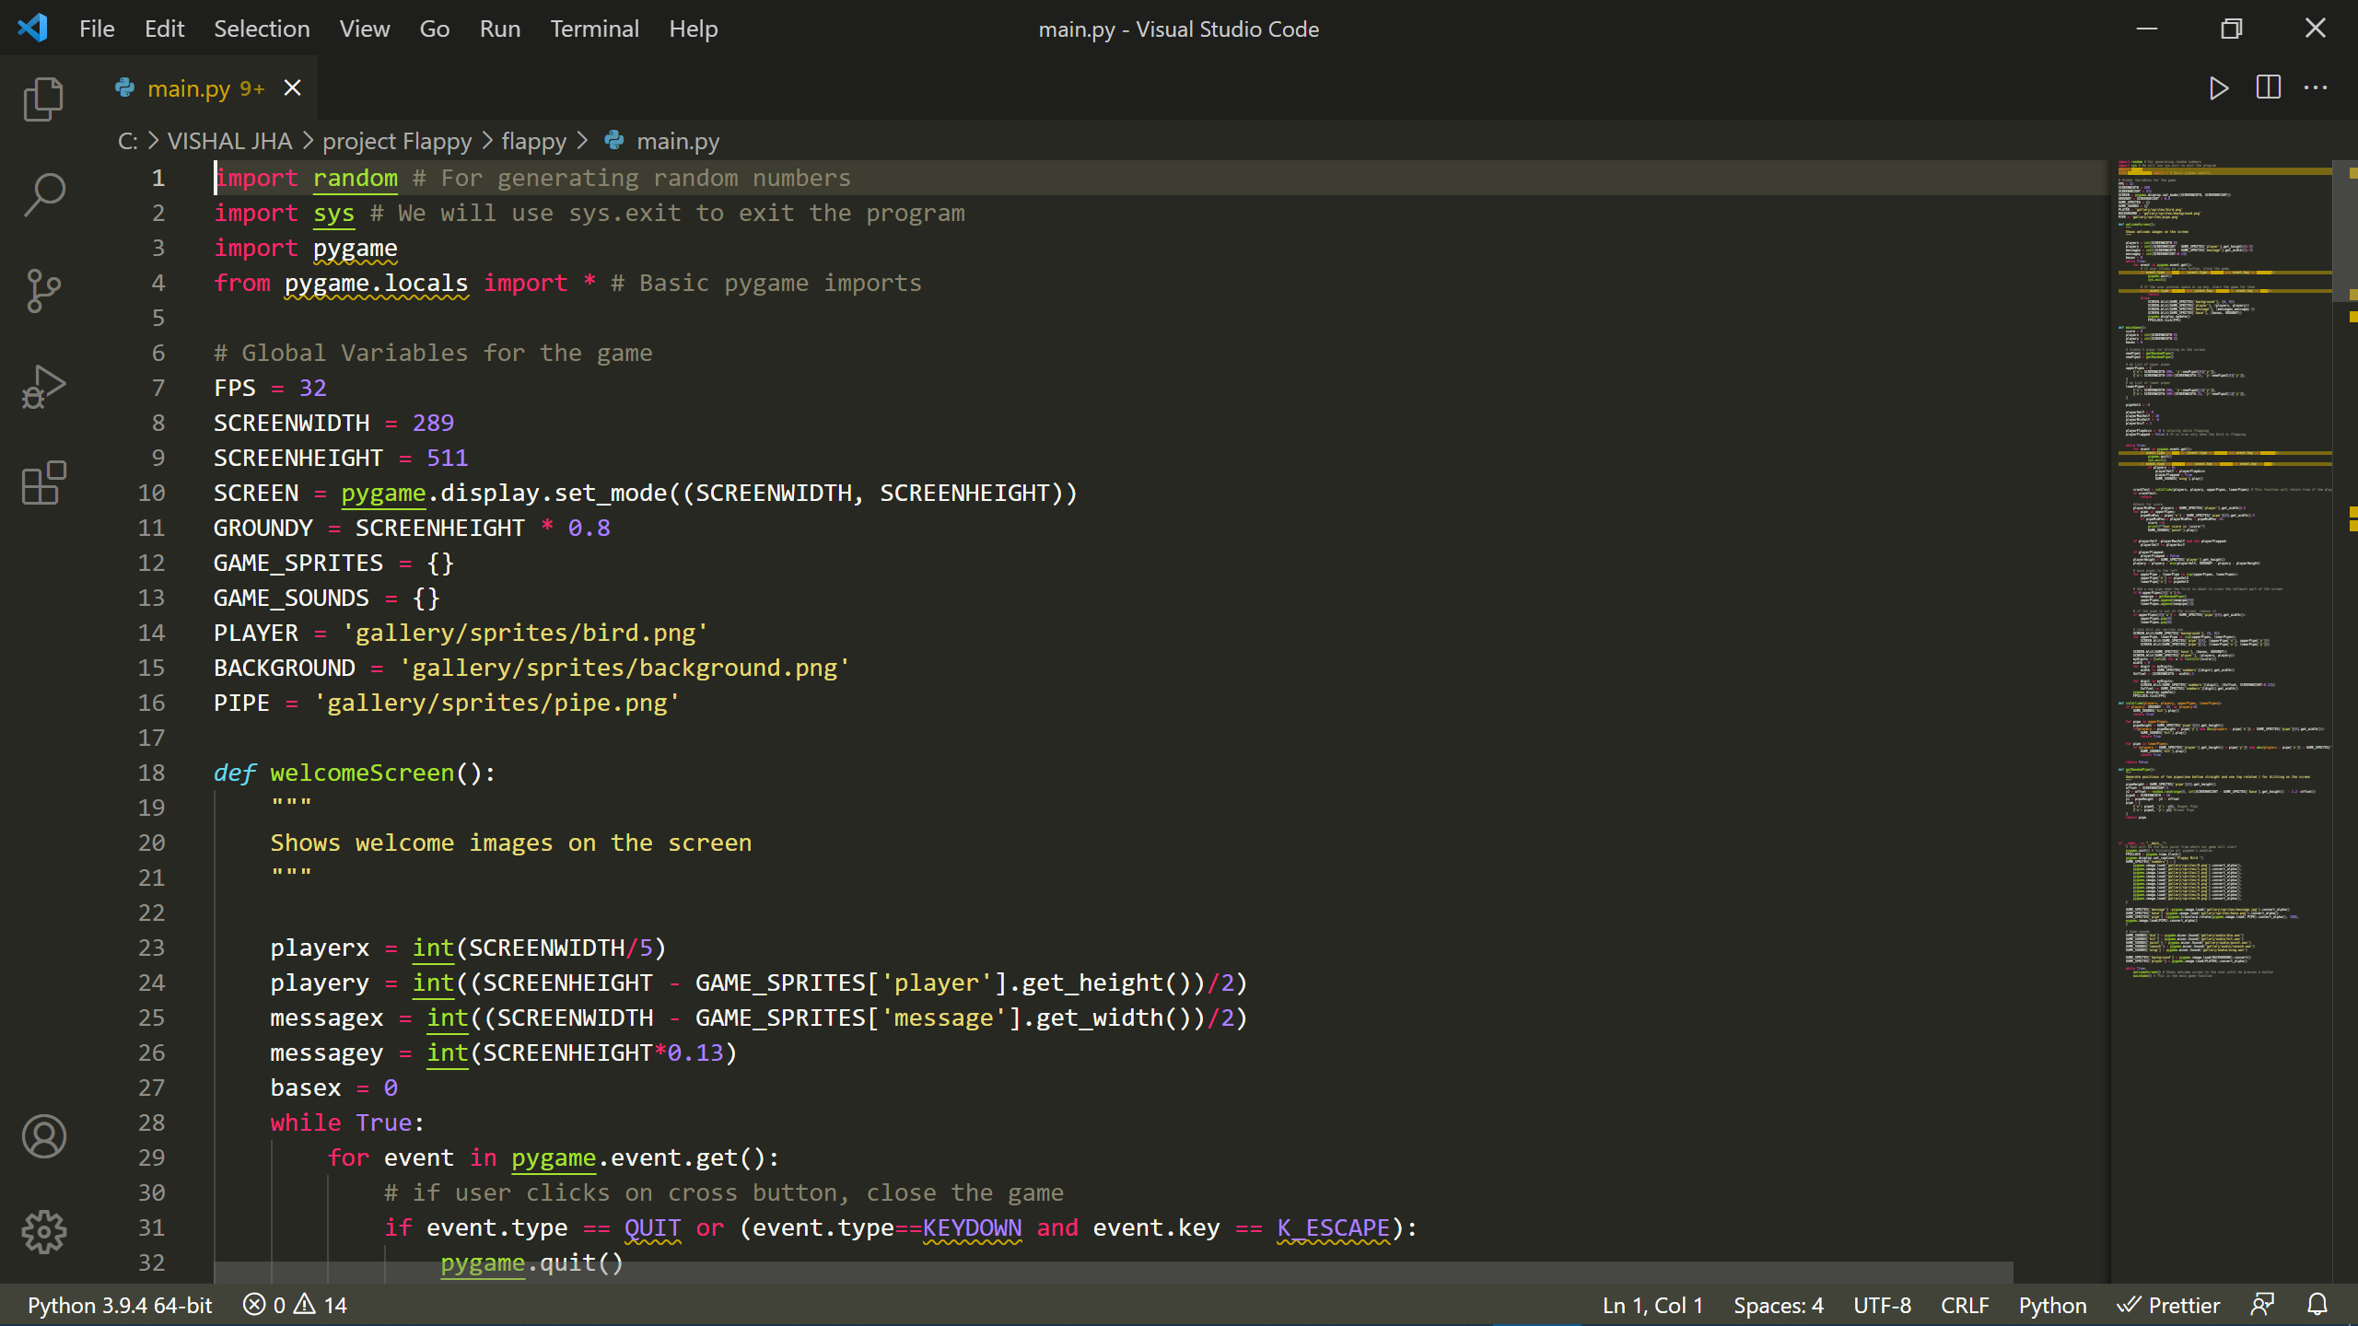
Code Appendix

Slide 15
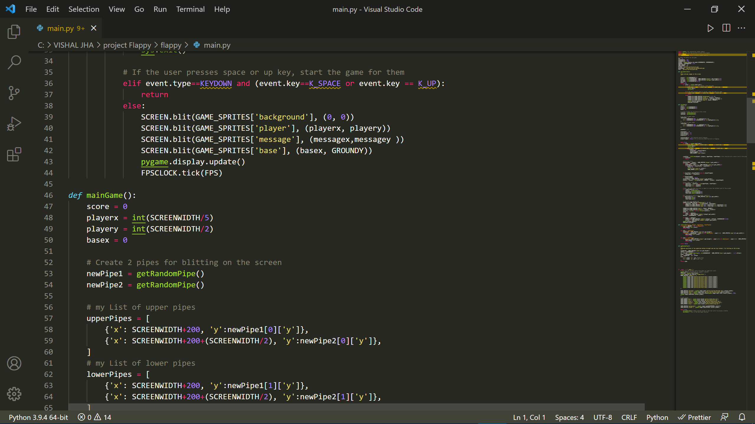

Slide 16
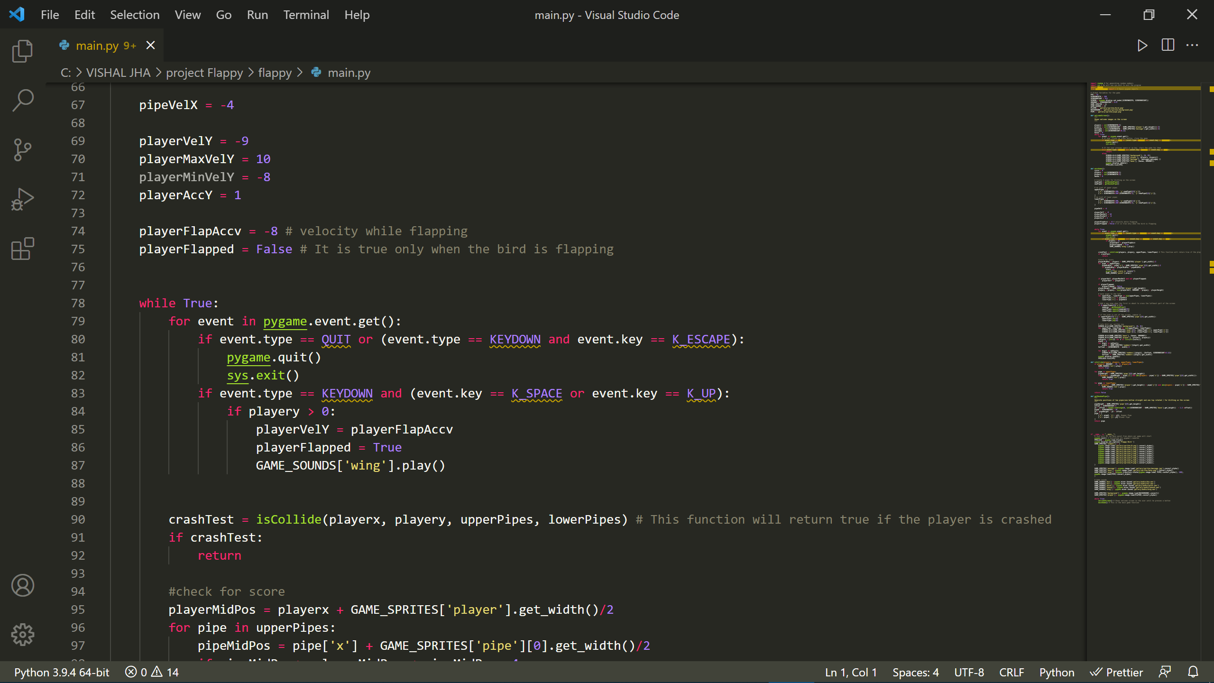

Slide 17
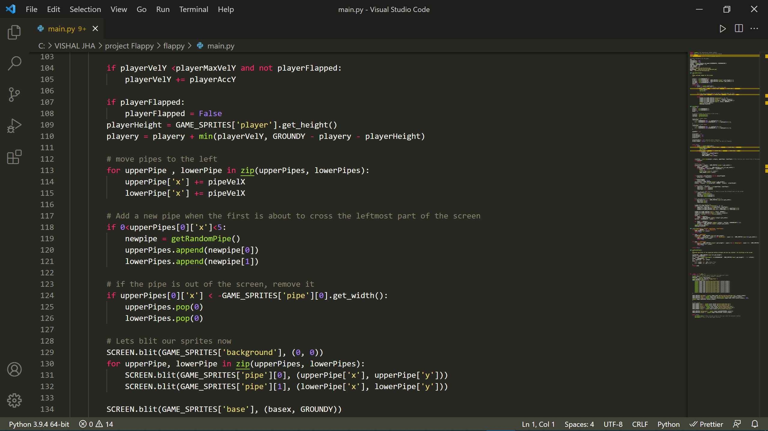

Slide 18
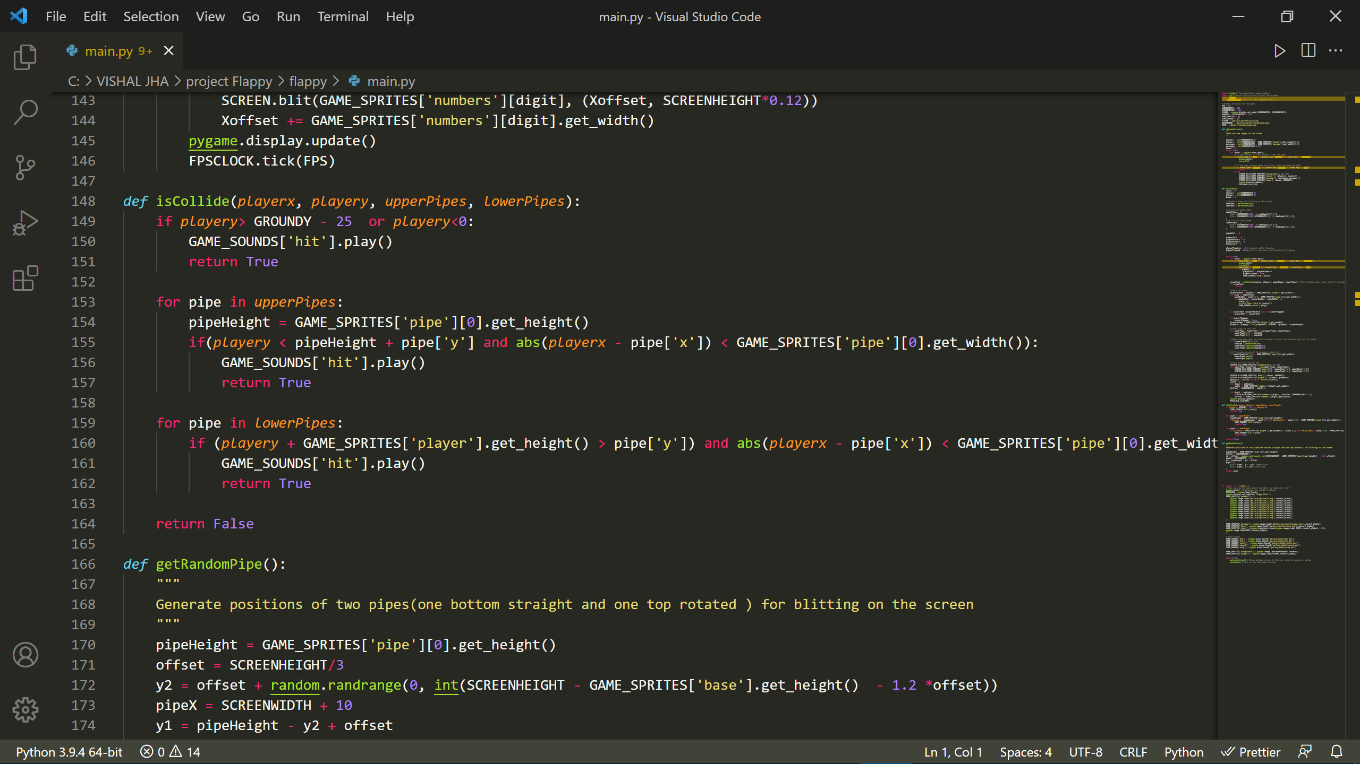

Slide 19
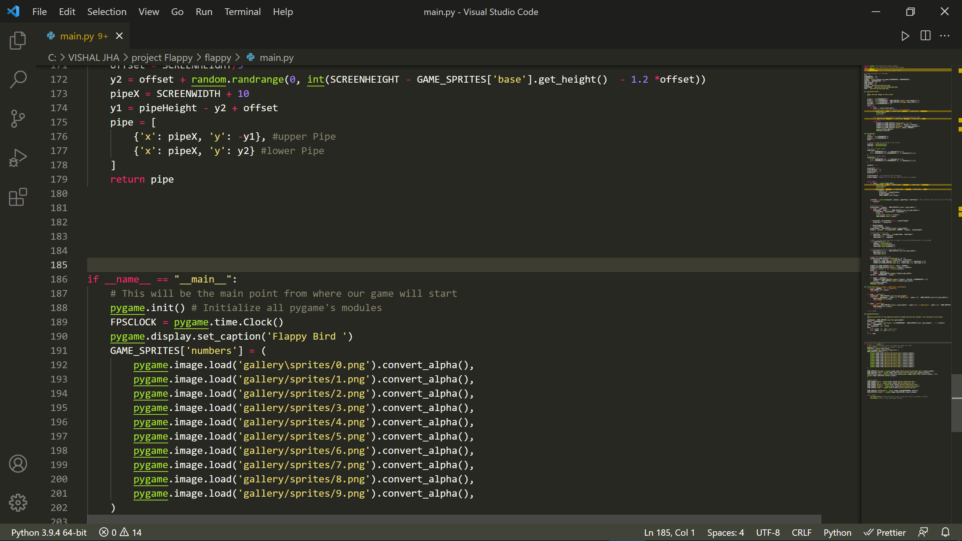

Slide 20
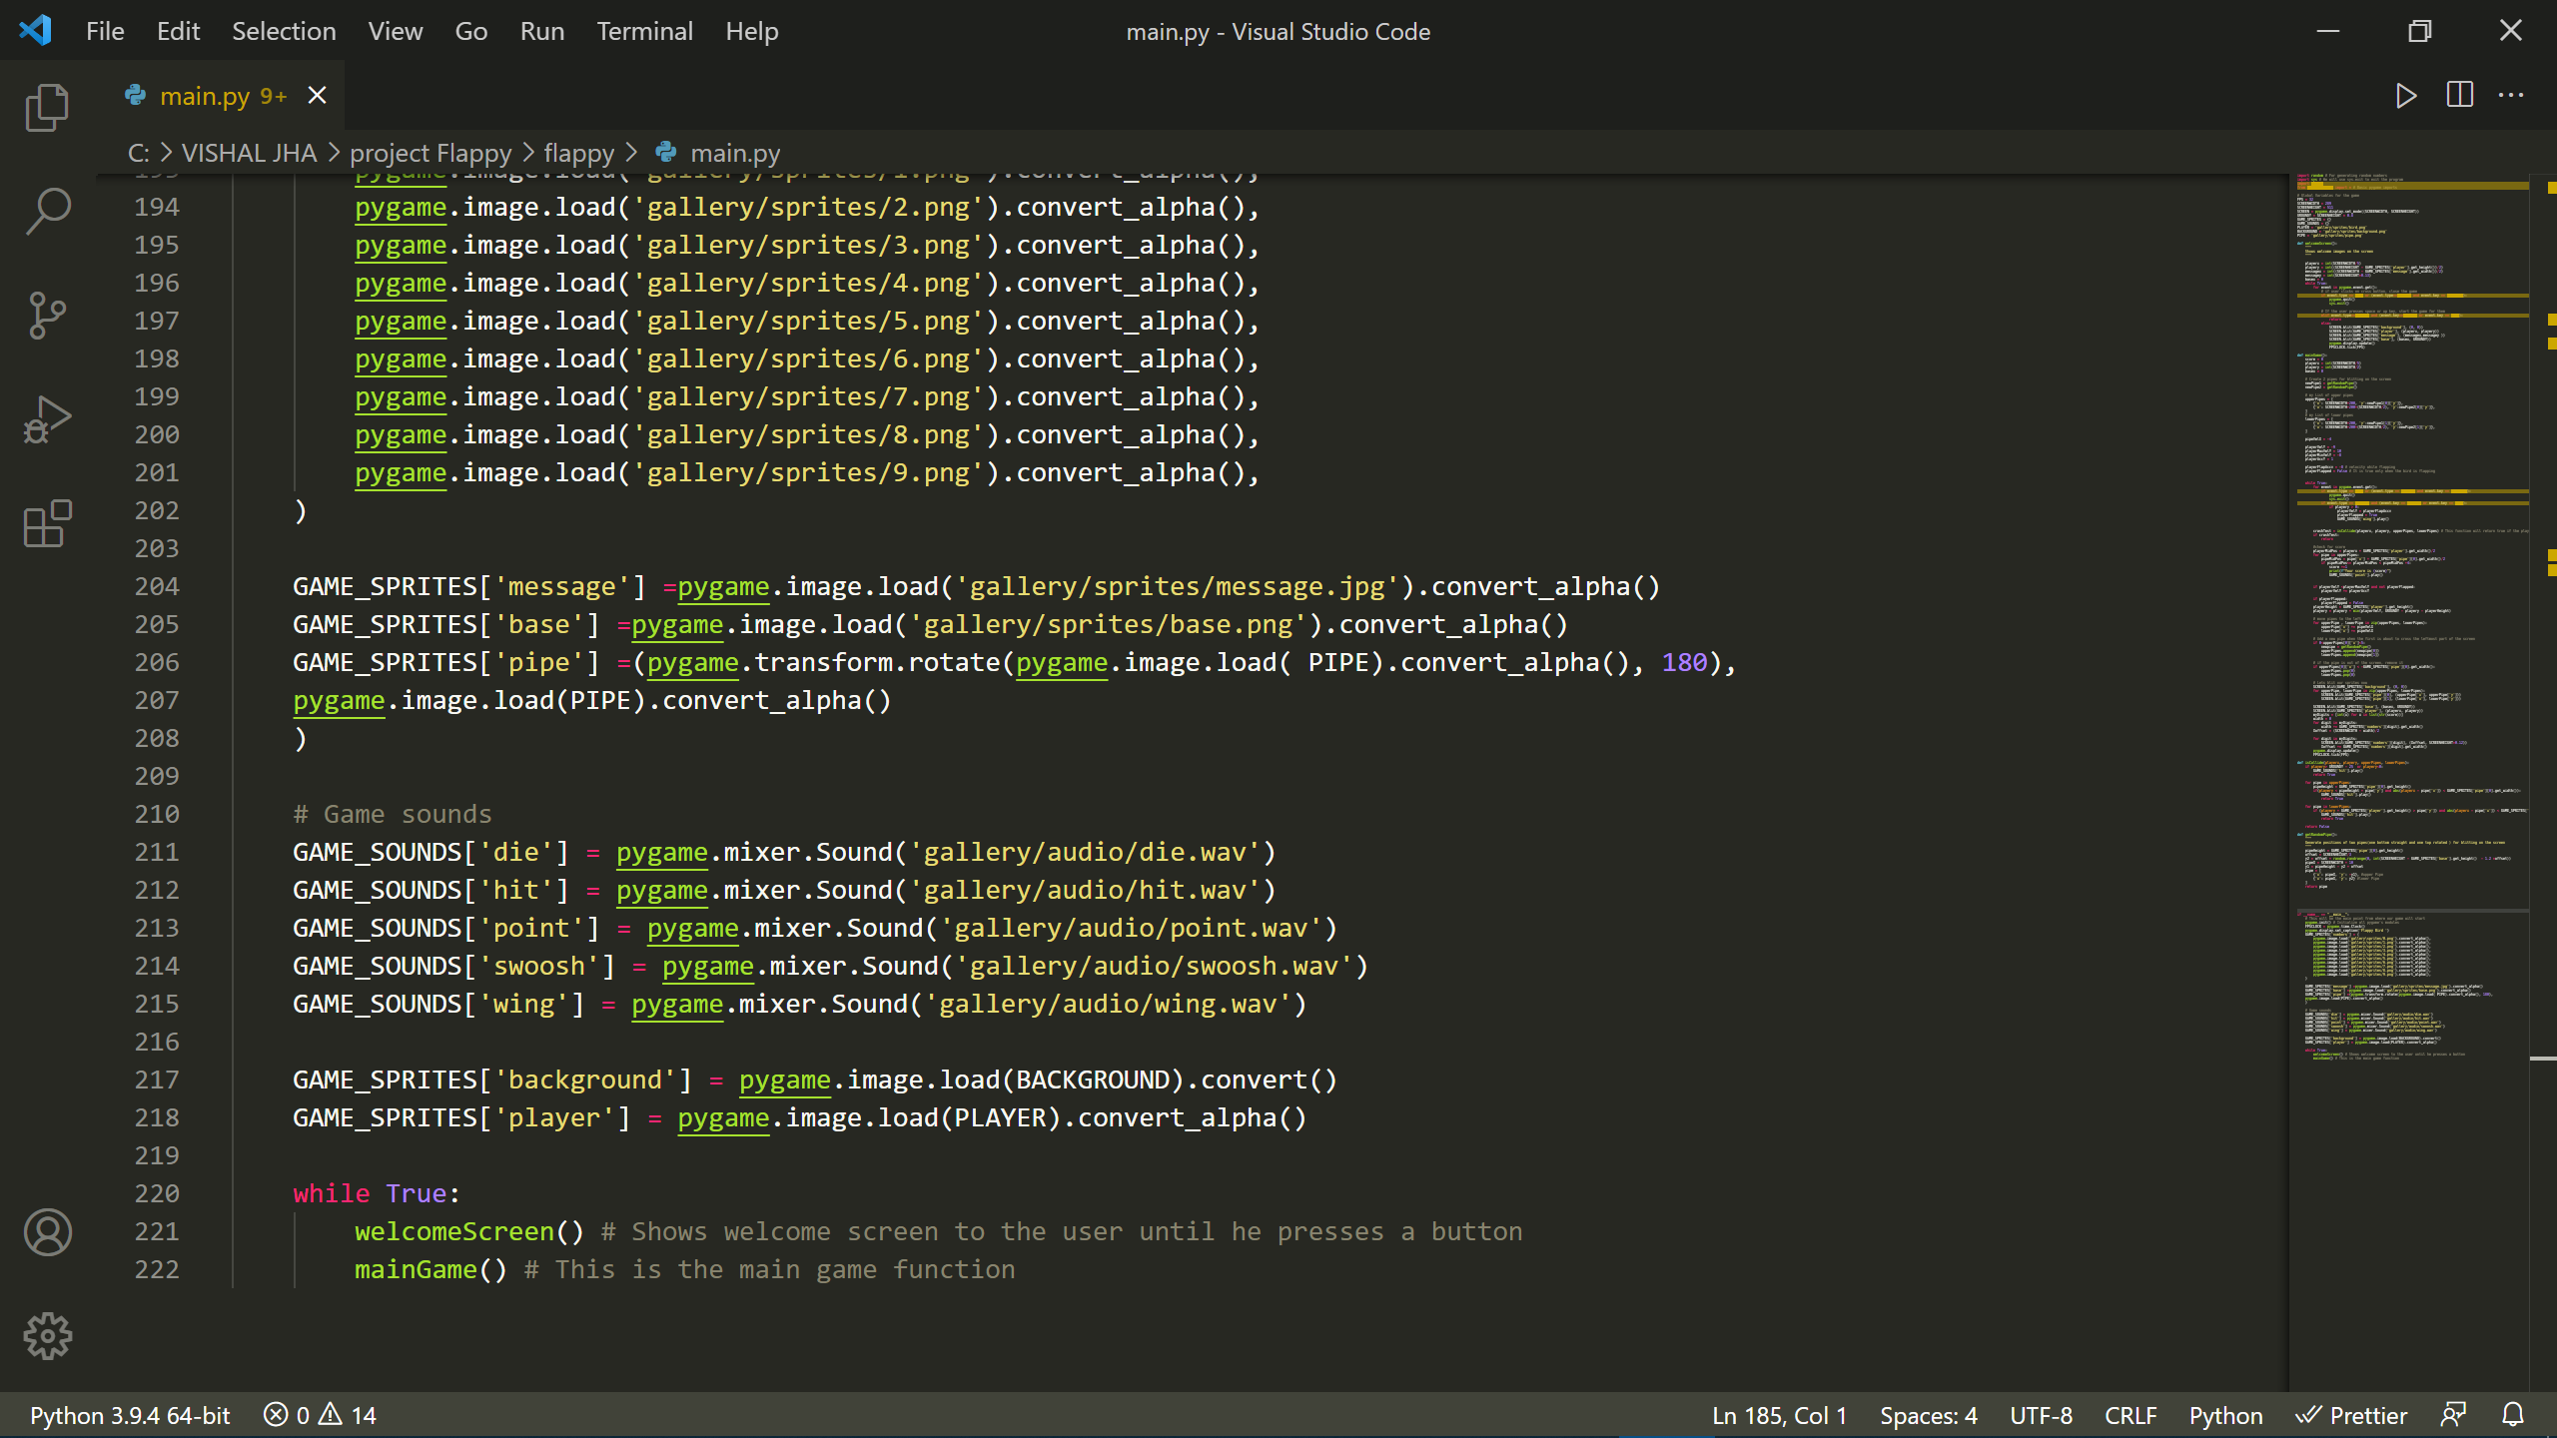

Slide 21
Thank You

